Slide 1
Assessing AI Scoring Accuracy for De Novo Proteins Elliott Taguchi Dickinson Master’s student
This project analyses a curated dataset of 400 experimentally validated de novo proteins targeting EGFR (provided by a contest held by AdaptyvBio) across eight different AI models
Tries to benchmark these state-of-the-art AI structure prediction models for scoring de novo protein designs
Calculating and analyzing RMSD, binding interfaces and other relevant metrics between models
Evaluating AI-based pre-screening as a method to reduce experimental validation burden in protein design pipelines
Methods include installing, preparing and running the AI models, including but not exclusively: AlphaFold3, OpenFold3, Boltz-2 and more.
Data analysis and data normalisation
Calculation of relevant metrics
Understand what each metric represents, and pick which one’s tell us relevant things

Slide 2
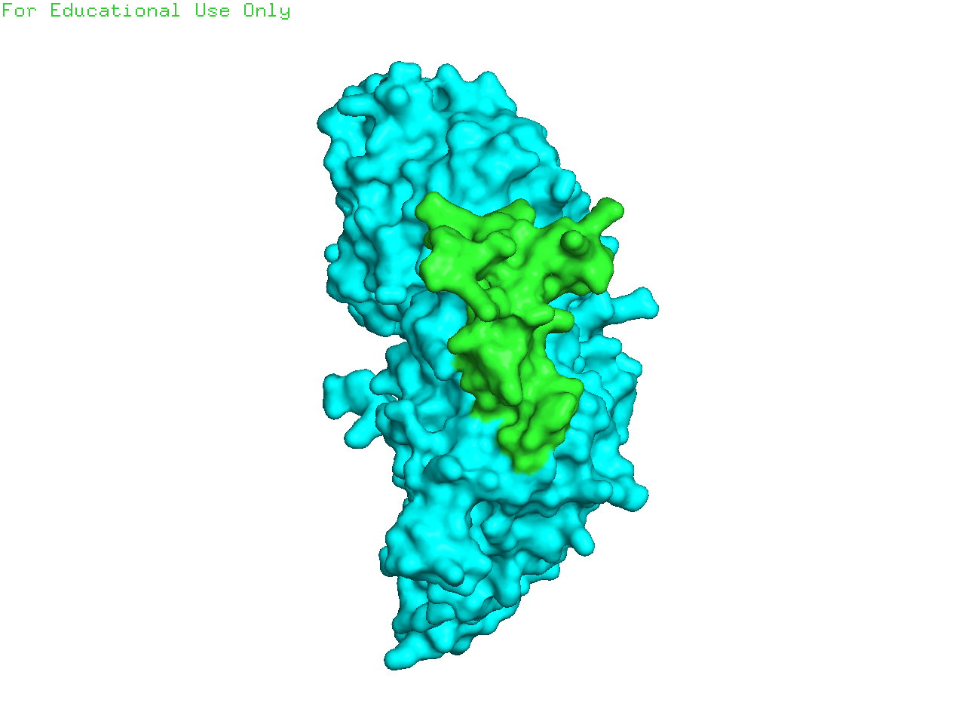
Assessing AI Scoring Accuracy for De Novo Proteins Elliott Taguchi Dickinson Master’s student
What the project wants to adress
To what extent do commonly used in silico metrics (e.g., pLDDT, IPAE, RMSD, TM-score) correlate with experimentally validated binding affinity in de novo protein designs?
Which sequence and structural features in de novo protein designs are most predictive of successful binding, based on the EGFR dataset?
How do different generative models (e.g., RFdiffusion, BindCraft) differ in design quality and scoring reliability, and what implications does this have for QC?
Do model-specific scoring outputs show consistent correlation with experimental binding success, and can these correlations inform QC strategies?
AF3 prediction of a complex, the blue part being the EGFR receptor, and green part the de novo binder. Created with PyMOL

